Slide 1


SQL Project
WORLDWIDE
ENERGY CONSUMPTION
Presented by
M.VAMSHI KRISHNA
P. SAI TEJA
YG. RUTHVIK

Slide 2

Introduction
In this project, we used Structured Query Language (SQL)
to analyse a comprehensive dataset containing information on:
Energy production and consumption
Gross Domestic Product (GDP)
Carbon emissions, Population statistics
By writing and executing SQL queries
we extracted meaningful insights related to:
Country-wise energy trends
Emission patterns over time
Economic and environmental performance comparisons

Slide 3

Objective
To maintain data consistency and integrity
using primary and foreign keys
To retrieve and manipulate data using SQL
To study the relationship between GDP growth
and energy/emission trends
To use SQL queries to extract, compute, and visualize insights from structured datasets

Slide 4
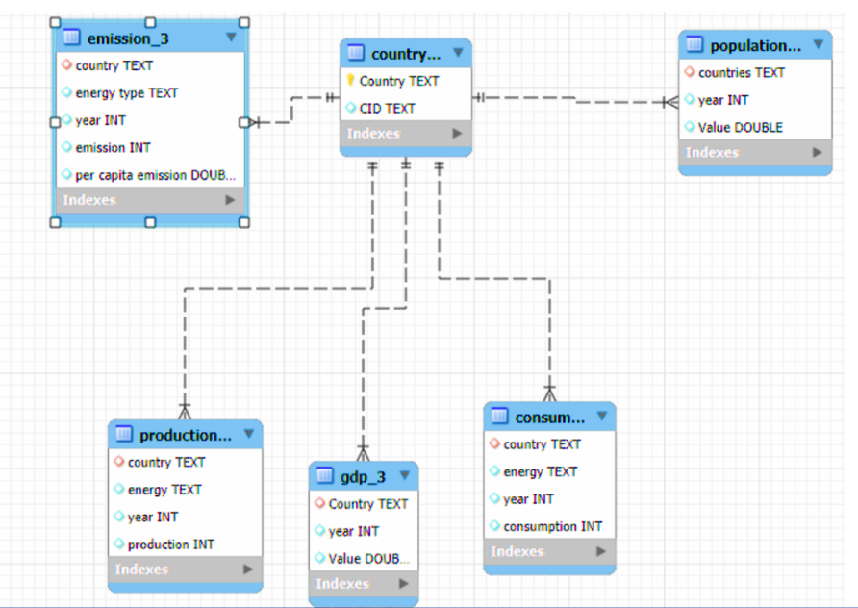
ER Diagram
ER Diagram

Slide 5
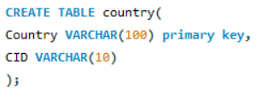
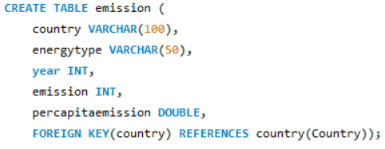
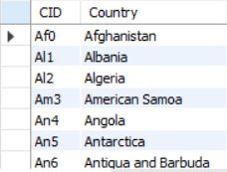
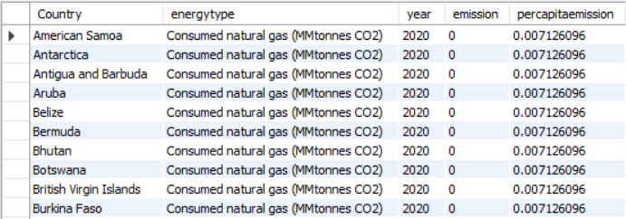
1.Country Table
2. Emission Table

Slide 6
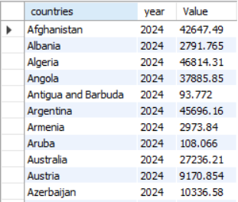
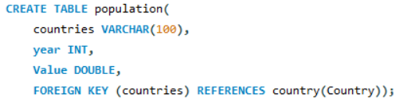
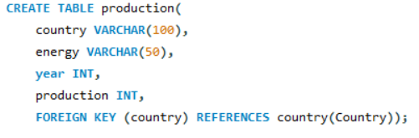
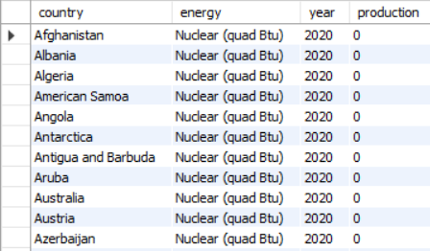
3.PopulationTable
4. Production Table

Slide 7
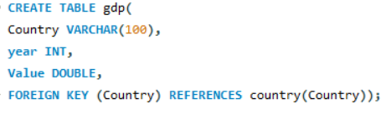
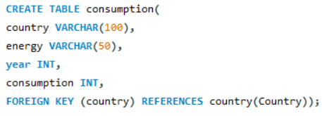
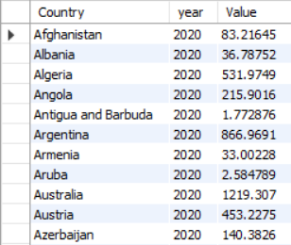
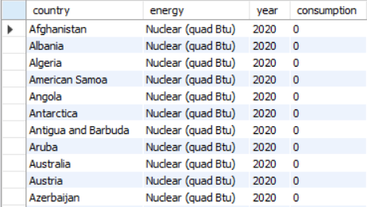
5.Gdp Table
6.Consumption Table

Slide 8

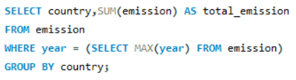
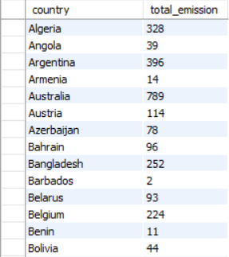
1.what is the total emission per country for the most recent year available?

Slide 9
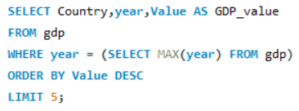
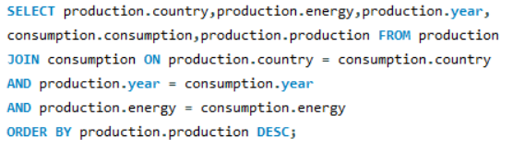
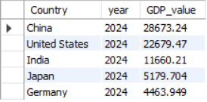
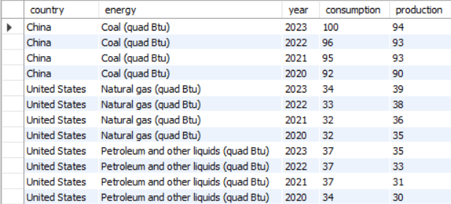
2.what are the top 5 countries by GDP in the most recent year?
3.compare energy production and consumption by country and year

Slide 10
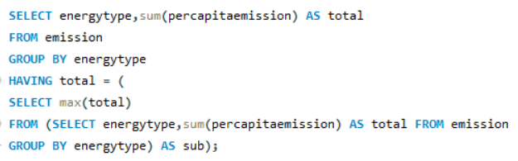

4.which energy types contribute most to emission across all countries?

Slide 11
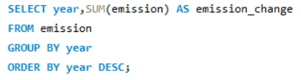
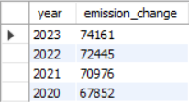
5.Trend analysis overtime how have global emissions changed over year?

Slide 12


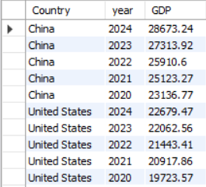
6.what is the trend in GDP for each country over the given years?

Slide 13
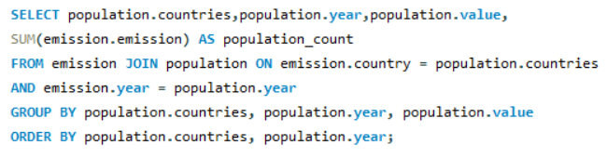
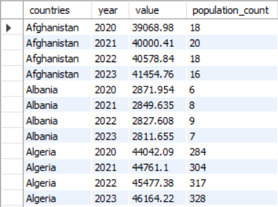
7.how has population growth effected total emissions in each country?

Slide 14
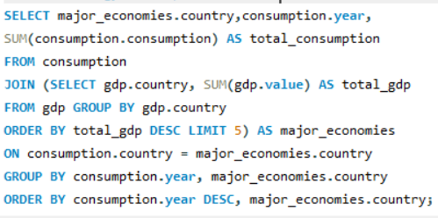
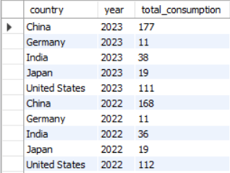
8.has energy consumption increased or decreased over the years for major economies?

Slide 15

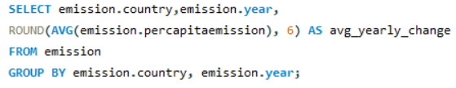
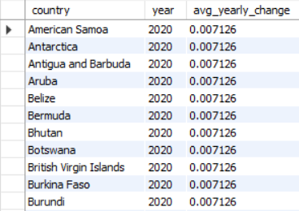
9.what is the average early change in emissions per capita for each country?

Slide 16
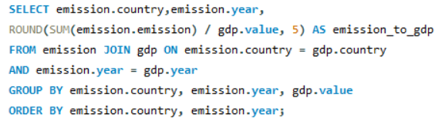
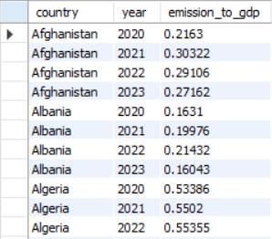
10.what is emission- to-GDP ratio for each country by year?

Slide 17
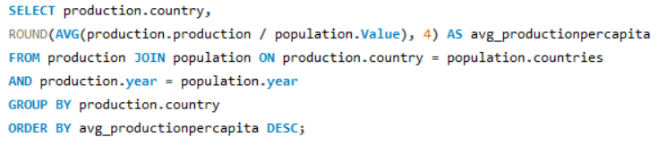
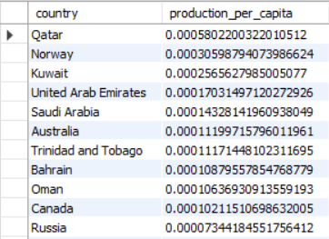
11.How does energy production per capita vary across countries?

Slide 18
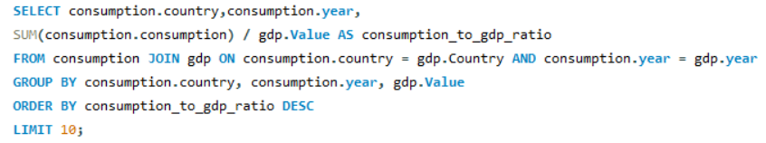
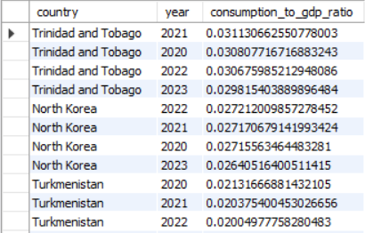
12.Which countries have the highest energy consumption relative to GDP?

Slide 19
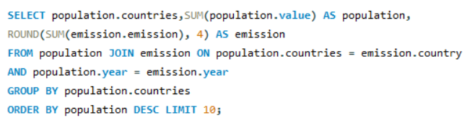
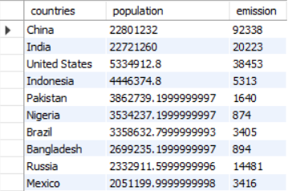
13.What are the top 10 countries by population and how do their emissions compare?

Slide 20
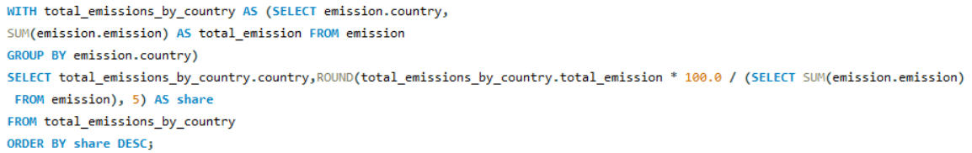
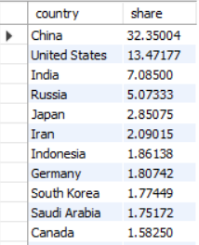
14.What is the global share (%) of emissions by country?

Slide 21
Conclusion
Through this project, we successfully used SQL to explore large datasets and uncover valuable insights about global energy production, GDP, emissions, and population trends.
We identified countries with high energy use and emissions, and those making sustainable progress.
The analysis showed clear links between economic growth and energy demand, as well as the environmental trade-offs.
Some nations demonstrated strong energy efficiency, producing higher GDP with lower emissions.
This project highlights the importance of data-driven decision-making in balancing economic development and environmental responsibility for a more sustainable future.

Slide 22
Thank you

